Slide 1
CMSC201 Computer Science I for Majors Lecture 01 – Introduction
Prof. Katherine Gibson
Based on slides by Shawn Lupoli at UMBC

Slide 2
Course Overview

Slide 3
Course Information
First course in the CMSC intro sequence
Followed by 202
CS majors must pass with a B or better
CMPE majors must get at least a C
No prior programming experience needed
Some may have it

Slide 4
About Me
Professor Katherine Gibson
Education
BS in Computer Science, UMBC
PhD, University of Pennsylvania
Likes
Video games
Dogs

Slide 5
What the Course is About
Introduction to Computer Science
Problem solving and computer programming
We’re going to come up with algorithmic solutions to problems
What is an algorithm?
We will communicate our algorithms to computers using the Python language

Slide 6
Class Objectives
By the end of this class, you will be able to:
Use an algorithmic approach to solve computational problems
Break down complex problems into simpler ones
Write and debug programs in the Python programming language
Be comfortable with the UNIX environment

Slide 7
Why Learn to Program?
Programming skills are useful across a wide range of fields and applications
Many scientific professions utilize programming
Programming skills allow you to understand and exploit “big data”
Logical thinking learned from programming transfers to many other domains

Slide 8
Grading Scheme
This class has:
8 Homeworks (4% each)
small programming assignments
2 Projects (8% each)
larger programming assignments
10 lab/discussion sections (1% each)
2 mandatory surveys (1% each)
A midterm (15%)
A comprehensive final exam (25%)

Slide 9
A Note on Labs
Your “discussion” section is actually a lab
In the Engineer building (021, 104, 104A, 122)
Labs are worth 10% of your grade
You must attend your assigned section
No points for attending other sections

Slide 10
Submission and Late Policy
Homeworks and projects will be submitted over the GL server with the submit command
Homeworks will always be due at 9 pm
Late homeworks will receive a zero
(In other words, there are no late homeworks)

Slide 11
Submission and Late Policy
It is not recommended that you submit close to the deadline
Sometimes the server gets overloaded with everyone trying to submit
Developing programs can be tricky and unpredictable
Start early and submit early (and often)

Slide 12
Academic Integrity

Slide 13
Academic Integrity
We have homeworks and projects in this class
You should never, ever, ever submit work done by someone else as your own.
If you submit someone else’s code, both students will get a 0 on the assignment.
Reminder: this a B-to-progress class for CMSC majors!

Slide 14
Things to Avoid
Copying and pasting another student's code
Leaving your computer logged in where another student can access it
Giving your code to another student
Attempting to buy code online
This will result in an immediate F in the class

Slide 15
Things that are Okay
And encouraged!
Talking to your friends about a problem
Helping a fellow student debug (as long as your hands don't touch the keyboard!)
Getting help from a TA or tutor

Slide 16
Why So Much About Cheating?
Every semester, around 20 students get caught sharing code. Typically, they are stressed, confused, and just wanted to take a shortcut or help a friend. These students endanger their entire academic career when they get caught.
If you feel like you can't possibly finish a project or homework on your own, contact someone in the course staff for help.

Slide 17
Getting Help

Slide 18
Where to Go for Help
There are a number of places you can go if you are struggling!
All of our TAs happy to help.
If the TAs aren't working out, come by the professors’ office hours (this should not be your first resort for help)
All office hours are posted on the website.

Slide 19
Additional Help
Tutoring from the Learning Resources Center
By appointment
Computer help from OIT
By phone or in person
See the syllabus on Blackboard for more info

Slide 20
Announcement: Note Taker Needed
A peer note taker has been requested for this class. A peer note taker is a volunteer student who provides a copy of his or her notes for each class session to another member of the class who has been deemed eligible for this service based on a disability. Peer note takers will be paid a $200 stipend for their service. Peer note taking is not a part time job but rather a volunteer service for which enrolled students can earn a stipend for sharing the notes they are already taking for themselves. If you are interested in serving in this important role, please fill out a note taker application on the Student Support Services website or in person in the SSS office in Math/Psychology 213.

Slide 21
UMBC Computing Environment
We develop our programs on UMBC’s GL system
GL is running the Linux Operating System
GUI – Graphical User Interface
CLI – Command-Line Interface
Lab 1 will walk you through using the UMBC computing environment

Slide 22
How Do I Connect to GL?
Windows
Download Putty (Lab 1 has a video about this)
Hostname – gl.umbc.edu
Make sure you pick SSH
Put in username and password
Mac
SSH client already installed
Go to the Application folder and select Utilities
Open up a terminal window
Enter the following: ssh -l username gl.umbc.edu
Put in your password

Slide 23
Linux Commands
See: http://www.csee.umbc.edu/resources/ computer-science-help-center/#Resources
Here’s a few basic commands:
ls – list contents
List files and directories in your current directory
Directory is just another word for folder

Slide 24
More Basic Commands
Important!! Commands are case sensitive
cd NAME – change directory
cd .. – go to parent directory
cd . – stay in current directory
mkdir NAME – make a new directory

Slide 25
Directories
(will be different for each person)
first/second/username
/afs/umbc.edu/users/first/second/username/home
201
otherClass
When you log into GL, you will be in your home directory
use the cd command to go to subdirectories
lab1
HW1
lab1.py

Slide 26
emacs – A Text Editor
Will use emacs to write our python code
emacs is CLI, not GUI
Need to use keyboard shortcuts to do things
Reference:
http://www.csee.umbc.edu/summary-of-basic-emacs-commands/

Slide 27
Keyboard Shortcuts for emacs
To open a file (new or old)
emacs filename_goes_here.txt
To save a file
CTRL+X then CTRL+S
To save and close a file
CTRL+X then CTRL+C
To undo
CTRL+_ (that “CTRL + Shift + -” for underscore)

Slide 28
Computers and Programs (Zelle Chapter 1)

Slide 29
Today’s Objectives
To have a very basic overview of the components of a computer system
To understand how data is represented and stored in memory
To be aware of elements of the UMBC computing environment
To start thinking algorithmically

Slide 30
Computing Systems
Hardware Components
Central Processing Unit (CPU)
Auxiliary Processors (GPU, etc)
Memory
Bus
Network Connection
External Devices: keyboard, monitor, printer
Software Components
Operating System: Linux, MacOS, Windows, etc
Applications

Slide 31
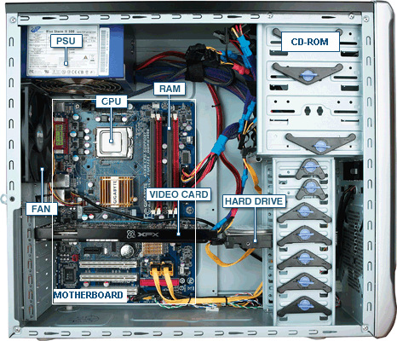
Inside of a Desktop Computer

Slide 32
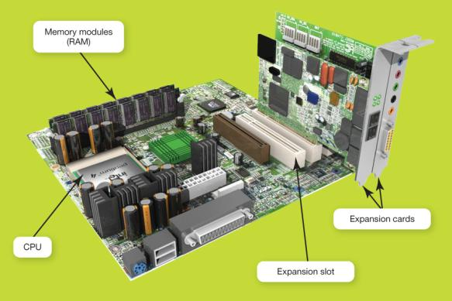
The Motherboard
CPU
RAM
Expansion cards and slots
Built-in components
Notes:
The motherboard is the key circuit board holding the essential processing parts. Attached directly to the motherboard are the CPU, RAM, expansion cards, and in many new computers, networking, modem, video, and audio components.

Slide 33
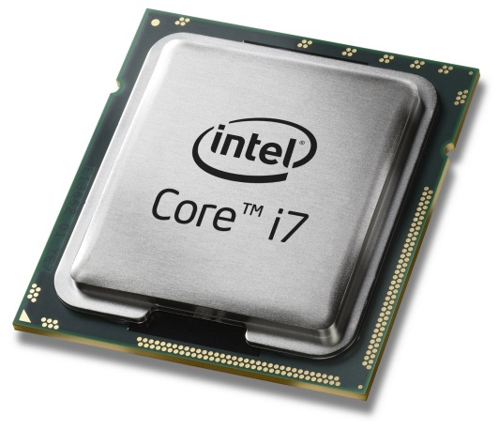
Central Processing Unit (CPU)
Referred to as the “brains” of the computer
Controls all functions of the computer
Processes all commands and instructions
Can perform billions of tasks per second
Notes:
The central processing unit (CPU, or processor) is the largest and most important chip in the computer.
It is sometimes referred to as the “brains” of the computer because it controls all the functions performed by the computer’s other components and processes all the commands issued to it by software instructions.
Modern CPUs can perform 6 billion tasks a second without error, making them extremely powerful components.

Slide 34
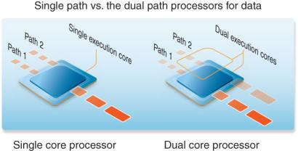
CPU Performance Measures
Speed
Megahertz (MHz)
Gigahertz (GHz)
Cores
Single
Dual
Quad
Eight
Hundreds?
Notes:
CPU clock speed is one measure of the CPU’s performance. Processor speed is measured in hertz or “machine cycles per second.” Older computers ran at speeds measured in megahertz (MHz) or millions of machine cycles per second. Current systems run at speeds measured in gigahertz (GHz) or billions of machine cycles per second.
CPU performance is also affected by the number of cores, or processing paths, the processor has. Processors have been designed that have two, four, and even eight cores.

Slide 35
Binary Numbers
Computers store all information (code, text, images, sound,) as a binary representation
“Binary” means only two parts: 0 and 1
Specific formats for each file help the computer know what type of item/object it is
But why use binary?

Slide 36
Decimal vs Binary
Why do we use decimal numbers?
Ones, tens, hundreds, thousands, etc.
But computers don’t have fingers…
What do they have instead?
They only have two states: “on” and “off”
Notes:
We use decimal because we have 10 fingers, so 10 different things we can use to count with.

Slide 37
Decimal Example
How do we represent a number like 50,932?
2 x 10⁰ = 2
3 x 10¹ = 30
9 x 10² = 900
0 x 10³ = 0000
5 x 10⁴ = 50000
------
Total: 50932
ten thousands
thousands
hundreds
tens
ones
5
0
9
3
2
10⁴
10³
10²
10¹
10⁰
Decimal uses 10 digits, so…

Slide 38
Decimal Example
Let’s do the same with 10110 in binary
0 x 2⁰ = 0
1 x 2¹ = 2
1 x 2² = 4
0 x 2³ = 0
1 x 2⁴ = 16
--
Total: 22
sixteens
eights
fours
twos
ones
1
0
1
1
0
2⁴
2³
2²
2¹
2⁰
Binary uses 2 digits, so our base isn’t 10, but…

Slide 39
Binary to Decimal Conversion
Step 1: Draw Conversion Box
Step 2: Enter Binary Number
Step 3: Multiply
Step 4: Add
2⁹ | 2⁸ | 2⁷ | 2⁶ | 2⁵ | 2⁴ | 2³ | 2² | 2¹ | 2⁰
512 | 256 | 128 | 64 | 32 | 16 | 8 | 4 | 2 | 1
1 | 0 | 1 | 0 | 0 | 0 | 1 | 1 | 0 | 1
512 | 0 | 128 | 0 | 0 | 0 | 8 | 4 | 0 | 1
512+0+128+0+0+0+8+4+0+1 = 653

Slide 40
Decimal to Binary Conversion
Step 1: Draw Conversion Box
Step 2: Compare decimal to highest remaining binary.
Step 3: If remainder is higher add 1 and subtract
Step 4: Repeat until 0
Convert 643 to binary
2⁹ | 2⁸ | 2⁷ | 2⁶ | 2⁵ | 2⁴ | 2³ | 2² | 2¹ | 2⁰
512 | 256 | 128 | 64 | 32 | 16 | 8 | 4 | 2 | 1
1 | 0 | 1 | 0 | 0 | 0 | 0 | 0 | 1 | 1
643-512 = 131
131-128 = 3
3-2=1
1-1=0

Slide 41
Exercise: Converting From Binary
What are the decimals equivalents of…
101
1111
100000
101010
1000 0000
(Longer binary numbers are often broken into blocks of four digits for readability.)

Slide 42
Exercise: Converting From Binary
What are the decimals equivalents of…
101 = 4+0+1 = 5
1111 = 8+4+2+1 = 15
100000 = 32+0+0+0+0+0 = 32
101010 = 32+0+8+0+2+0 = 42
1000 0000 = 128+...+0+0 = 128
(Longer binary numbers are often broken into blocks of four digits for readability.)

Slide 43
Converting to Binary
What are the binary equivalents of…
9
27
68
1000

Slide 44
Converting to Binary
What are the binary equivalents of…
9 = 1001 (or 8+1)
27 = 0001 1011 (or 16+8+2+1)
68 = 0100 0100 (or 64+4)
1000 = 0011 1110 1000 (or 512+256+128+64+32+8)

Slide 45
“Levels” of Languages
Machine Code (lowest level)
Code that the computer can directly execute
Binary (0 or 1)
Low Level Language
Interacts with the hardware of the computer
Assembly language
High Level Language
Compiled or interpreted into machine code
Java, C++, Python

Slide 46
Compilation vs Interpretation
Compiler
A complex computer program that takes another program and translates it into machine language
Compilation takes longer, but programs run faster
Interpreter
Simulates a computer that can understand a high level language
Allows programming “on the fly”

Slide 47
Algorithmic Thinking
Algorithms are an ordered set of clear steps that fully describes a process
Examples from real life:
Recipes
Driving directions
Instruction manual (IKEA)

Slide 48
Exercise: PB&J Algorithm
English speaking aliens are visiting Earth for the first time. They want to know how to make a peanut butter and jelly sandwich.
Explicitly, what are the required steps for building a peanut butter and jelly sandwich?

Slide 49
Announcements
No Labs for week of August 26th and 27th
Make sure to log into the course Blackboard
Let us know if you have any problems
Course website will be announced when it is completed

